Slide 1

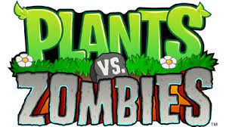

7: Optimal PLANTS VS. ZOMBIES STRATEGY
204ver
Chuyang Li, GAOYUAN BAO, Allen Zhang, RUNDONG YU

Slide 2
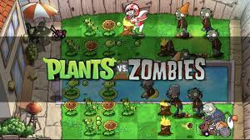
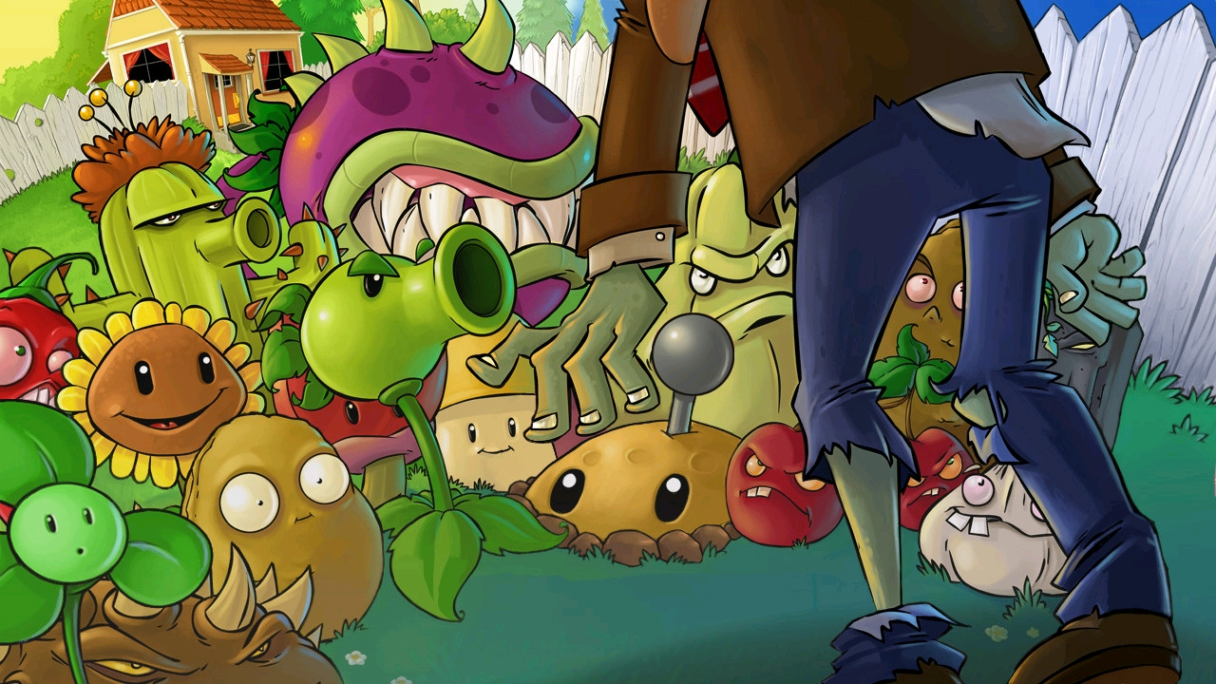
Main IDEAS for plants vs. zombies
Plants vs. Zombies is a video game. Players can quickly and effectively block zombies on the road of invasion by arming a variety of plants to switch different functions.
A model will correspond to controls the plants to resist the attack of zombies successfully, when resist the attack of a certain number of zombies successfully, then that means plants win.

Slide 3
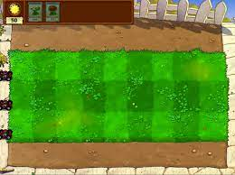
Basic table/rules
We have a 3*10 table for this vision, the range in which plants can be placed： P_{x2} ---P_{x9} (x means any rows is available).
If Zombies reach P_{x1}, we lose the game (return false).
Sun appears randomly anywhere on the board, one every 5 seconds. Use Sun to get Plants.
When place plants on the table, we mark it as P_{xy} (each P means True) and every Zombie exist, we mark it as Z_{xy} (each Z means false).
Zombies appear 4 times first, and each time will have a 20 seconds interval
When the number of Zombies becomes to zero, Plants win(retrun true)

Slide 4

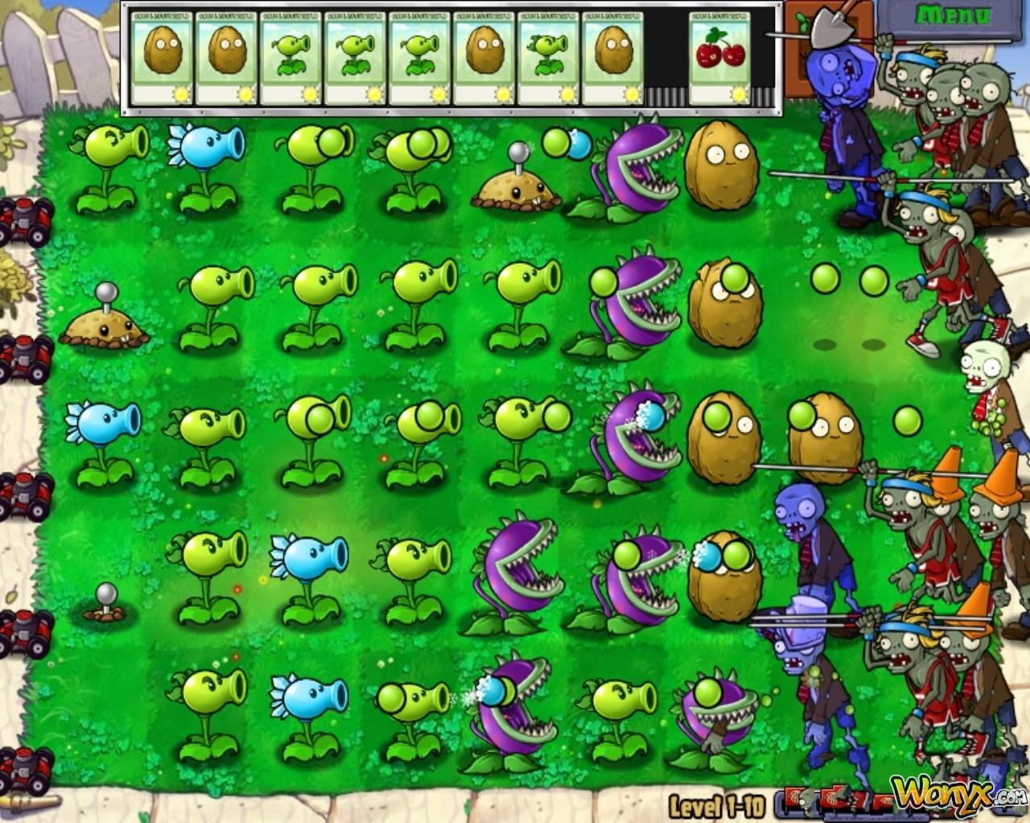
Basic table/rules
The Zombie fixed volume, fixed time moving in a grid, Zombie meet with plants and they will after 2 seconds
No matter how many zombies in one plants( but please don't let it be alone), they must stop and attack, until this plants' health reduce to zero.
After this place (Px)be cleared(return false), then zombies continue to move

Slide 5
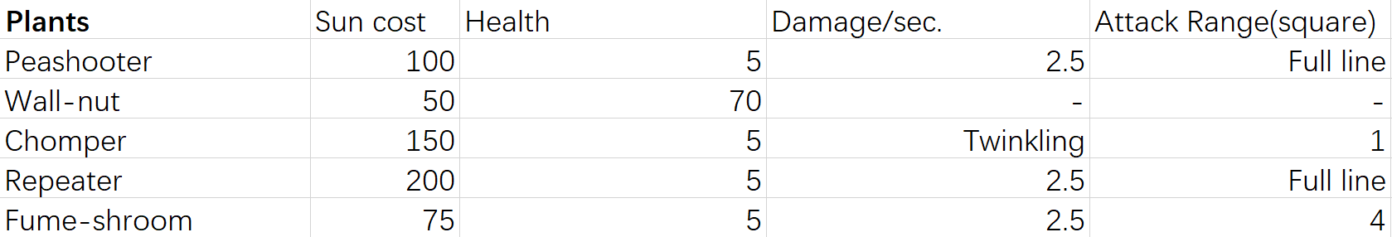
Plants
In this game, we choose several representative plants in our version. Because the rate at which we get the sun is very high, we did not use sunflower. Instead, we think taking damage will be the primary goal.
The only plant that can slow down the movement of zombies is wall-nut, zombies need to spend a lot of time to eat it. Zombies will take a lot of damage during this period.

Slide 6
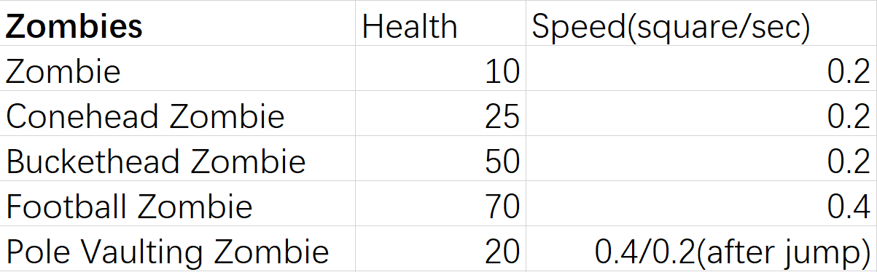
Zombies
We choose 5 different kinds of zombies in our version, they have different health, speed and characteristic so We need different plant strategies to eliminate them.

Slide 7
Constraints
When the game not finish, which means still have Zombies, can be represented :
Z₁₁ ∧ Z₁₂ ∧ Z₁₃ ∧ Z₁₄ ∧ Z₁₅ ∧ Z₁₆ ∧ Z₁₇ ∧ Z₁₈ ∧ Z₁₉ ∧ Z₁₀ ∧ Z₂₁ ∧ Z₂₂ ∧ Z₂₃ ∧ Z₂₄ ∧ Z₂₅ ∧ Z₂₆ ∧Z₂₇ ∧ Z₂₈ ∧ Z₂₉ ∧ Z₂₀ ∧ Z₃₁ ∧ Z₃₂ ∧ Z₃₃ ∧ Z₃₄ ∧ Z₃₅ ∧ Z₃₆ ∧ Z₃₇ ∧ Z₃₈ ∧ Z₃₉ ∧ Z₃₀ ,return false
No Zombies, which means win the game, will return true.
Lose the game:
Z₁₁ ∧ Z₂₁ ∧ Z₃₁ return false
So, in simplest way, we win the game by time finish: ~P(1-30) for Zombies, stop the game by ~P1,1 | P2,1 |P3,1 having Zombies.

Slide 8
End

